Slide 1
Building careers and writing resumes
Lecture 07
Yasir saleem

Slide 2
Finding the ideal opportunity
As you craft your personal strategy, keep these three guidelines in mind:
Get organized: The job search process could last months and involve multiple contacts with dozens of companies. Keep your data organized and track the important dates.
Start early and stick to it: Even if you are a semester or more away from graduation, now it is not too early to get started. Plan and research. Waiting for the last minute will end up in losing opportunities.
Look for stepping-stone opportunities: You might not find the desired opportunity right away in today’s tough job market. Take a job that doesn’t meet your expectations. It will help learning workplace skills, observing effective and ineffective business practices and fine tune your career planning.

Slide 3
Writing the story of you
“Remember this is a private document designed to help you clarify your thoughts and plans”
Where I Have Been: Experiences from your past give you an insight into where would you like to go in the future?
Where I Am Now: Where do you stand now in terms of your education and career and what do you know about yourself?
Where I Want to Be: What would you like your future to be? What do you like and dislike? What would you like to explore? If you haven’t figured everything out yet, that’s fine, as long as you have started to think about the future

Slide 4
Learning to think like an employer
Put yourself into their boots.
The ability to perform your job is an essential part of your potential. However, reliability and motivation is also what hiring managers look for.
A great way to get inside the heads of the corporate recruiters is to listen and read their professional conversations.

Slide 5
Researching industries and companies of interest
Employers expect you to be familiar with important developments in their industries.
Keep yourself updated and stay on top of the business news.
Research about the company and the industry prior to submitting your application whenever you come across any opportunity.

Slide 6
Translate your general potential into a specific solution for each employer
An essential task in your job search is presenting your skills and accomplishments in a way that is relevant to the employer’s business challenges.
Customize your resume for each job opportunity.

Slide 7
Taking the initiative to find opportunities
Don’t hesitate to contact the interesting companies even if they haven’t advertised the job openings to the public yet – they might be looking for somebody just like you.
Identify the companies you want to work for and focus your efforts on them.
Contact the HR departments or individual managers, if possible. Your message will sound right, if the company is looking for someone but hasn’t advertised it yet.

Slide 8
Building your network
Networking is the process of making informal connections with mutually beneficial business contacts.
Networking is more essential than ever because the vast majority of the job openings are never advertised to the general public.
Start thinking like a networker now; your classmates could turn out to be some of your most important business contacts.
Put your network in place before you need it.
Use LinkedIn, Twitter etc.
Remember that networking is about people helping each other, not just about other people helping you. It is a mutual beneficial activity.
Try to learn something about the people you want to connect with, don’t overwhelm others with too many messages, don’t give out other people’s names and contact information without permission, never email your resume to complete strangers and remember to say thank you every time someone helps you.

Slide 9
Seeking career counseling and avoiding mistakes
Don’t overlook the many resources available through the department’s career development center.
Avoid a simple blunder that can torpedo a job search, such as not catching mistakes in your resume, misspelling a manager’s name you are writing to, showing up late for the interview, sending unprofessional messages and posts, failing to complete application forms correctly and making any error that can flag you as someone who is careless and disrespectful.

Slide 10
Planning your resume
Resume a structured, written summary of your education, employment background and job qualifications will be the most important document in the job application process.
Developing a resume is a project that really benefits from multiple sessions of planning, writing and completing spread over several days and weeks. Since, you are trying to summarize a complex subject (yourself!!!) and present a compelling story to strangers in a brief document.
You will come across lots of ideas and even some conflicting advice about resumes; use what you know about effective business communication to decide what is right for your resume.
To forge your own successful path through this maze of information, get inside the heads of people you are trying to reach – try to think the way they think.

Slide 11
Fallacies and facts about resumes
FALLACY | FACT
The purpose of the resume is to list all your skills and abilities | The purpose of the resume is to kindle employer interest and generate an interview
A good resume will get you the job you want | All a resume can do is get you in the door
Your resume will always be read carefully and thoroughly | In most cases, your resume needs to make a positive impression within a few seconds; only then will someone read it in detail. Moreover, it might be screened by a computer for keywords first, a human being may never see it
The more good information you present about yourself in the resume, the better it is. So stuff your resume with every positive detail | Recruiters don’t need that much information about you at the initial screening stage and they probably wont read it

Slide 12
Organizing your resume around your strengths
The Chronological Resume: The work experience section dominates and is placed immediately after your contact information and introductory statement in a reverse chronological order. It is the most common approach but it might not be right for you at this stage of the career. Being recent graduates and having limited professional experience, you can vary this approach by putting your educational qualification before your experience.
The Functional Resume: Sometimes called as a skill resume, emphasize your skills and capabilities before the educational and professional experience. This format is often considered by people with limited or spotty employment history but many employment professionals are suspicious of it since it obscures the work history.
The Combination Resume: It meshes the skill focused approach of functional format with the job history focus of the chronological format. If you don’t have a lot of work history to show, consider a combination resume to highlight your skills while still providing a chronological history of your employment.

Slide 13
Addressing the areas of concern
Frequent job changes: Try to justify your frequent job shifts, if not in the resume then in the covering email or letter. If you have various short term jobs, group them under a single heading.
Gaps in work history: Specify the relevant education you gained during employment gaps or fill it with volunteered or community works.
Inexperience: List relevant coursework and internships.
Overqualification: Tone down your resume, focusing exclusively on the required experience and skills.
Long-term employment with one company: Itemize each position held within the company that reflects the growth and increasing responsibilities.
Job termination for cause: Be honest with the interviewers and address their concerns with proofs, such as recommendation letters and project completion certificates.
Criminal record: Do not specify it on the resume, however if asked during the interview or the background check, emphasize on the rehabilitation and commitment of being a law abiding citizen and a trustworthy employee.

Slide 14
Writing your resume
With the necessary information and a good plan you are now ready to begin writing.
Imagine yourself to be someone else who is writing the resume for this person “You”. This will help finding the right words and the ideas to flow more easily.
A good practice is to swap your resume writing project for a while with a classmate. It will help speeding up the writing for both of you.

Slide 15
Keeping your resume honest
No matter what, DO NOT lie in the resume.
Applicants with integrity know they don’t need to stoop to lying.
Always remember that the employers will carry out a background check.
Given the networked nature of today’s job market, lying on a resume could haunt you for years and you could be forced to keep lying throughout your career to hide the misrepresentation in your original resume.

Slide 16
Adapting your resume to your audience
Always tailor make your resume to best fit the the requirements of the employer for the advertised job.
Repeat this process for your every job application.
Translate your past accomplishments into a compelling picture of what you can do for the employers in the future.
For jobs where the inflow of applicants is high, companies use applicant tracking system, that matches your resume to the employer’s requirements. Therefore use terminologies that are mentioned in the job description.

Slide 17
Composing your resume
Write your resume using a simple and direct style. Use short, crisp phrases built around strong verbs and nouns.
Avoid using the word “I”. It sounds repetitive and reflects self-involvement.
Start your phrases with strong verbs such as accomplished, developed, coordinated, initiated, administered, explored, forecasted, strengthened, recommended, organized, succeeded, participated etc..
Include relevant keywords.

Slide 18
Name and contact information
It constitutes the heading of your resume. Include your name, address, email, phone numbers, URLs to your portfolios.
Be sure to provide complete and accurate contact information.
Use a professional sounding email address for business correspondence, such as firstname.lastname@something.com.

Slide 19
Introductory statement
You can choose to open with a career objective, a qualifications summary or a career summary.
Do not copy a career objective from the internet.
If you have a reasonably focused skill set but don’t yet have a long career history, a qualification summary is the best type of introductory statement for you.
A career summary offers a brief recap of your career with a goal of presenting increasing levels of responsibilities and performance.
Whichever option you choose, make sure it includes many of the essential keywords.

Slide 20
education
If you are early in your career, your education is probably your strongest selling point.
Present your education in depth, choosing facts that support your theme and in a chronological order.
It can also include the certifications and technical trainings you have received.
List your GPA only if it is good or asked by the employer. If you don’t specify it on the resume the interviewer may ask about it during the interview.
If your grades are better in the major courses, you can specify a Major GPA pertinent to those courses only.

Slide 21
Work experience, skills and accomplishments
This section will be called as your “Work Experience” or “Professional Experience”. List it in the reverse chronological order.
When you specify past job responsibilities, identify the skills and knowledge that you can apply to the future job.
If you have limited experience, you can include any volunteered job experience, community services or internships.
Devote most space to the jobs that are related to your target position.
Facts about your skills and achievements are the most important information you can give to a prosperous employer. Quantify them whenever possible.
If you have a number of part time, temporary or entry level jobs that do not relate to the current opening, use your judgement skills to either include or exclude them. If you have limited career, you can always include them so as to give an impression of your willingness to continue working.

Slide 22
Activities and achievements
Include personal achievements and activities outside the educational and work context only if they suggest special skills or qualities that are relevant to the job you are seeking.
For example, traveling, studying and fluency in multiple languages could weigh heavily in your favour if you are applying for a multinational company.
Include community service activities that reflect leadership, teamwork, communication skills or technical aptitude.

Slide 23
Personal data and reference
Do not put your picture on the resume.
If not asked for, do not write your marital status, CNIC number, religion, sect etc.
Always include references at the end.
Make sure that you inform them once you apply for the job and keep them updated about your career.

Slide 24
Completing your resume
Revise your resume until it is as short and clear as possible.
If your employment history is brief, keep your resume to a single page.
Choose an effective resume design that enables the readers to find essential information in a matter of seconds.
Produce versions of your resume in multiple formats.
Your resume can’t be “pretty good” or “almost perfect” – it needs to be ”perfect” so proof read it thoroughly and ask several other people to verify it.

Slide 25
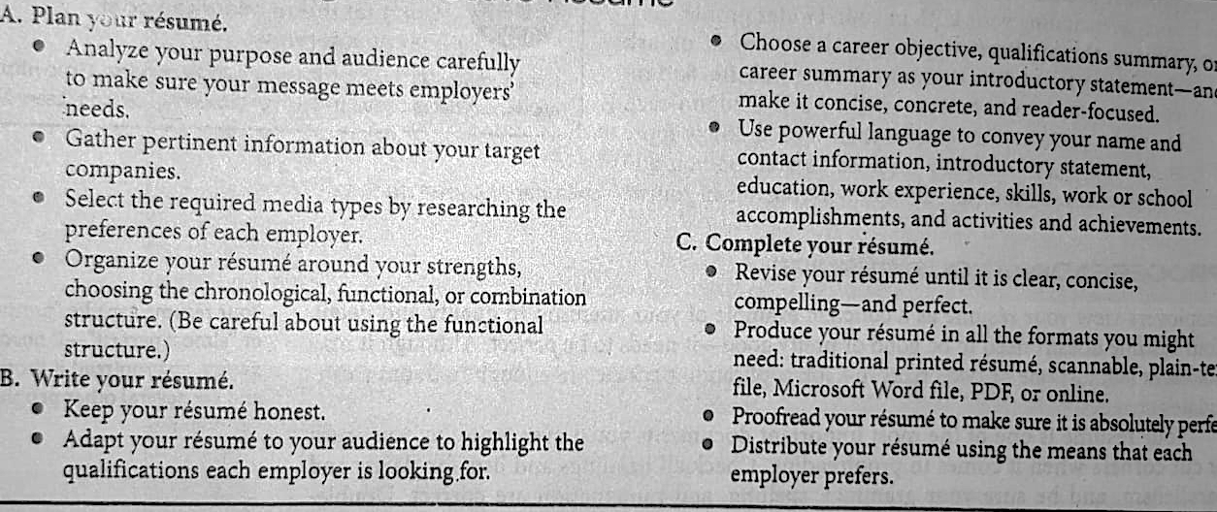
Checklist for writing an effective resume

